Slide 1
Employee Data Analysis using Excel
STUDENT NAME: DEVA DHARSHINI P
REGISTER NO: 122201886
DEPARTMENT: lll B.com(cs)
COLLEGE: Chevalier T.Thomas Elizabeth college
For women

Slide 2
PROJECT TITLE
Employee Performance Analysis using Excel

Slide 3

AGENDA
Problem Statement
Project Overview
End Users
Our Solution and Proposition
Dataset Description
Modelling Approach
Results and Discussion
Conclusion
3/21/2024 Annual Review

Slide 4

PROBLEM STATEMENT
High employee turnover is adversely affecting our organization’s productivity, morale, and finances, with a 25% increase in the past year. The main contributing factors are limited career growth opportunities, inadequate compensation, and poor work-life balance. Our objective is to reduce turnover by 15% over the next 12 months.

Slide 5

PROJECT OVERVIEW
The project is focused on reducing the organization’s employee turnover rate, which has increased by 25% in the past year, negatively affecting productivity, morale, and costs. We plan to identify the root causes, including career growth, compensation, and work-life balance, and implement strategies aimed at achieving a 15% reduction in turnover over the next 12 months.

Slide 6

WHO ARE THE END USERS?
The primary users of this project are the organization’s employees and managers. Employees will enjoy enhanced career development opportunities, improved compensation, and a better work-life balance. Managers, on the other hand, will benefit from reduced turnover, increased team stability, and greater productivity. Moreover, the human resources team will leverage the strategies and tools created to track and sustain employee satisfaction and retention.

Slide 7

OUR SOLUTION AND ITS VALUE PROPOSITION
Our solution is a comprehensive employee retention strategy that emphasizes enhancing career development opportunities, providing competitive compensation, and encouraging a healthier work-life balance. This approach is designed to reduce turnover by boosting employee satisfaction and engagement, resulting in lower recruitment and training costs, increased productivity, and a stronger workplace culture. The value proposition is a more stable and motivated workforce that supports long-term organizational success and competitiveness.

Slide 8
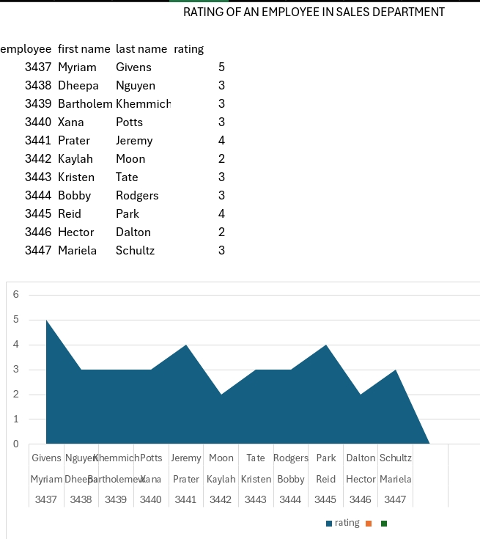
Dataset Description
Our solution surpasses traditional retention strategies by utilizing data-driven insights to craft a personalized employee experience. By applying predictive analytics, we can pinpoint employees at risk of leaving and proactively address their needs through tailored career development plans, personalized incentives, and customized work-life balance initiatives.

Slide 9

THE "WOW" IN OUR SOLUTION
We will use predictive modeling techniques, including logistic regression and machine learning algorithms such as decision trees and random forests, to analyze employee data and identify factors that influence turnover. This approach will allow us to predict which employees are at risk of leaving and understand the root causes, enabling targeted interventions like personalized development plans and customized incentives to reduce turnover and enhance overall employee satisfaction.
9

Slide 10
MODELLING
Microsoft Excel spreadsheets allow individuals to organize and display their data visually with models. Excel models are an effective way to forecast future events and occurrences. Learning about Excel modeling can help you make better decisions and predictions for your organization based on past data.
10

Slide 11
RESULTS
11

Slide 12
Conclusion
By utilizing predictive modeling to pinpoint key factors contributing to turnover and applying targeted retention strategies, we aim to decrease employee turnover by 15% within a year. This strategy will boost employee satisfaction, reduce recruitment and training expenses, and enhance overall productivity and morale, resulting in a more stable and successful organization.

